Slide 1








Slide 2




Indent
Basic Paragraph
Capital
Period
Letter

Slide 3



Slide 4



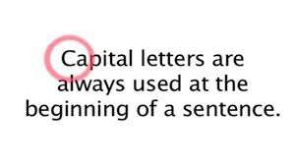


🞇Use a period at the end of every sentence.

Slide 5
What is a paragraph?
🞇 A paragraph is a group of sentences with one topic.
🞇 A paragraph consist of more than one sentence.
🞇 Form, content, and structure are very important in a paragraph.

Slide 6







Parts of a Paragraph
🞇 A Paragraph has three parts:
Supporting
Sentences
Topic
Conclusion
Sentences
Parts of a Paragraph

Slide 7
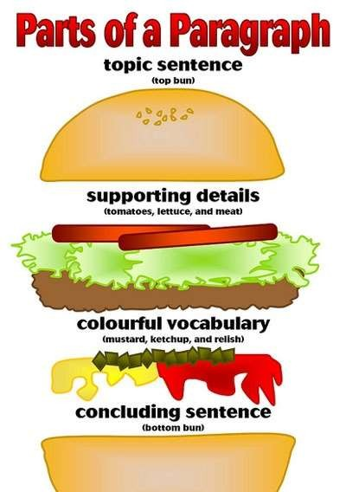

Slide 8
Topic Sentences
🞇It is usually the first sentences in a paragraph.
🞇It is also the most general sentences in a paragraph.
🞇It introduces the main idea of a paragraph.
🞇Summarize the main idea of your paragraph. Indicate to the reader what your paragraph will be about.

Slide 9
Supporting Details
🞇Supporting Details come after the topic sentence.
🞇 Write at least 3 supporting sentence.
🞇They support the information of the topic sentence.
🞇You should give supporting facts, examples, and details.
🞇 This will help the reader understand your topic better.

Slide 10
Concluding Sentences
🞇This is the last sentence in a paragraph.
🞇It reminds what the topic sentence was about.
🞇It restates the main idea of a paragraph using different words.

Slide 11
An Effective Paragraph;
🞇 presents a single idea
🞇 begins with a topic sentence that makes this single idea evident
🞇 contains support in form of sentences that convey this single idea
🞇 is strategically organized to maintain flow
🞇 informs and entertains your reader about your paper’s overall idea
🞇 Use transition words

Slide 12
Common Types of Paragraphs
🞇Narrative
🞇Expository
🞇Descriptive
🞇Persuasive
🞇Classification
🞇Compare and Contrast

Slide 13

Process to Write a
Paragraph

Slide 14
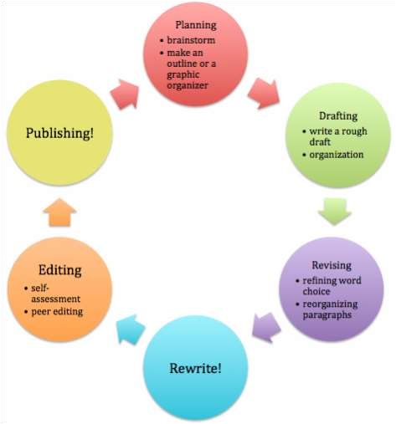













Brainstorming
Organizing
Ideas
Final Work
First Draft
Editing

Slide 15
For a Good Paragraph;
🞇 Brainstorm ideas around a central topic.
🞇 Arrange your points in a logical order.
🞇 Write the topic sentence.
🞇 Add supporting details and evidence.
🞇 Use clear, simple sentences with transition words.
🞇 Tie it all together with a conclusion sentence.
🞇 Edit your paragraph for grammar, style, and coherence.

Slide 16


